Slide 1

Cognitive Clock – Midterm Project Proposal
Student: María José Viveros Riquelme
Course: ITAI 1378 – Computer Vision and AI
Date: October 30, 2025

Slide 2

Tier: 2 – Image Classification (Medical AI)
This project qualifies as Tier 2 because it involves a supervised image classification task using convolutional neural networks (CNNs), where input data are images and output labels correspond to cognitive scores or categories (Normal, Mild Cognitive Impairment, Dementia).
It requires dataset curation, preprocessing, model training, and evaluation, but does not demand multimodal fusion or large-scale segmentation, which belong to Tier 3 complexity. Following the ITAI-1378 guidelines, Tier 2 projects demonstrate the ability to implement and fine-tune pretrained CNN architectures (e.g., ResNet-50) for a real-world problem with measurable metrics like accuracy and precision.

Slide 3
What is the Clock Drawing Test (CDT):
The Clock Drawing Test is a short neuropsychological assessment widely used to detect cognitive decline, Alzheimer’s disease, and dementia (Shulman et al., 1993; Pinto & Peters, 2009).Patients are asked to “draw a clock showing ten past eleven.” Clinicians then evaluate spatial organization, number placement, and hand positions. Errors such as missing numbers, incorrect spacing, or misplaced hands often indicate early cognitive impairment (Sunderland et al., 1989; Royall et al., 1998).

Slide 4
Target Audience:
The primary audience for this system is older adults (typically aged 60 and above) who are at risk of mild cognitive impairment (MCI) or early dementia. Secondary users include neurologists, neuropsychologists, geriatricians, and caregivers who can benefit from an AI-assisted tool for early detection and remote monitoring. This digital approach enables accessible and low-cost screening, especially useful in rural or resource-limited areas where specialists are scarce.

Slide 5

The Problem
Early cognitive impairment is often missed because clinicians manually score the Clock Drawing Test (CDT). Many health professionals do not use it regularly due to limited consultation time and the need for expertise to interpret results. Manual scoring can be slow, inconsistent, and subjective, which reduces its practicality as a screening tool in busy healthcare settings.
Who cares
Neurologists, psychologists, hospitals, caregivers, and especially primary care physicians who are often the first to detect cognitive changes. Automating the CDT would also help healthcare systems improve efficiency and enable large-scale community screening.

Slide 6
Why important
Early diagnosis supports timely interventions and slows disease progression because the use of the Clock Drawing Test (CDT) combined with Convolutional Neural Networks (CNNs) helps predict cognitive impairment objectively and efficiently. CNNs can analyze subtle visual patterns in patients’ drawings—such as distortions, spacing errors, or irregular hand placement—that may not be easily detected by human evaluators. This automated approach increases diagnostic accuracy, reduces clinician workload, and enables large-scale screening in primary care settings, making early detection of dementia more accessible, consistent, and data-driven.
Notes:
Example: Manual evaluation can take several minutes per patient and depends on each clinician’s judgment. By using AI-based models to score the drawings automatically, screening becomes faster, standardized, and scalable, allowing hospitals and clinics to detect cognitive decline in larger populations with greater reliability.

Slide 7
Solution
The proposed system, Cognitive Clock, uses a Convolutional Neural Network (CNN) to automatically analyze hand-drawn clock images and predict the level of cognitive impairment. The model learns from thousands of labeled drawings scored by clinicians, allowing it to recognize visual patterns linked to normal, mild, or severe impairment.
Summary
Cognitive Clock uses CNNs to predict cognitive impairment scores from simple clock drawings.

Slide 8

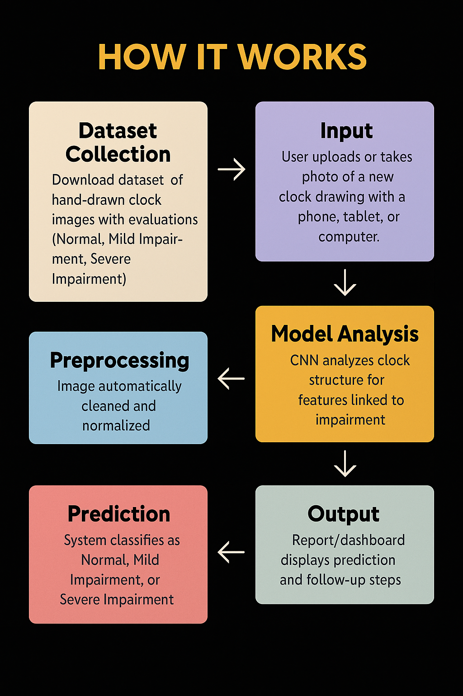

Slide 9
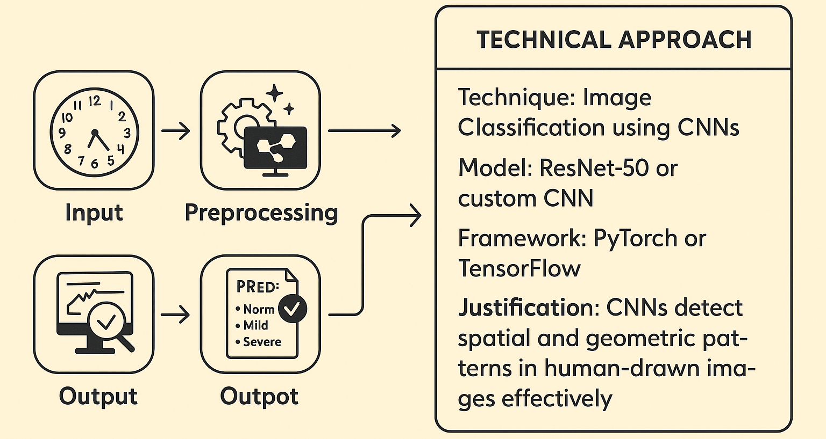
Notes:
How it works:
Dataset Collection: The process begins by downloading a dataset of hand-drawn clock images along with their respective clinical evaluations or scores. These images come from validated studies or hospital databases, where each drawing is labeled as Normal, Mild Impairment, or Severe Impairment according to expert assessment. This labeled data is essential for training the model to recognize cognitive patterns.
Input: The user (clinician, patient, or caregiver) uploads or takes a photo of a new clock drawing using a phone, tablet, or computer. The system ensures that the image is captured under proper lighting and quality conditions for reliable analysis.
Preprocessing: The image is automatically cleaned and normalized—removing background noise, adjusting brightness and contrast, and centering the clock to create consistent input data. This step prepares the image for accurate interpretation by the CNN.
Model Analysis: The Convolutional Neural Network (CNN) analyzes visual components such as number placement, clock-hand direction, proportionality, and symmetry. By comparing these features with patterns learned during training, the model identifies subtle markers of cognitive decline.
Prediction: Based on these patterns, the model generates a classification—Normal, Mild Impairment, or Severe Impairment—and assigns a quantitative score indicating the probability of each category.
Output: The system displays the results in a clear and user-friendly report or dashboard. It includes the predicted score, confidence level, and suggested next steps for clinical evaluation or monitoring.

Slide 10
Data Plan
Source: The dataset comes from the National Health and Aging Trends Study (NHATS), a large U.S. longitudinal study focused on aging and cognitive health. It includes Clock Drawing Test (CDT) images collected from older adults, along with clinical evaluations assessing cognitive performance. Each image is linked to diagnostic data that helps label the drawings as Normal, Mild Impairment, or Severe Impairment.
Size: Approximately 500–1,000 clock images with corresponding clinical scores are used for training and validation. This sample size ensures model generalization while maintaining computational efficiency for experimentation.
Preparation:
Before feeding the data into the CNN, images undergo several preprocessing steps to ensure consistency and enhance learning:
Resize all images to a fixed resolution (e.g., 224×224 pixels).
Normalize pixel values to balance contrast and lighting differences.
Augment the data with random rotations, brightness, and contrast adjustments to improve robustness and prevent overfitting.

Slide 11
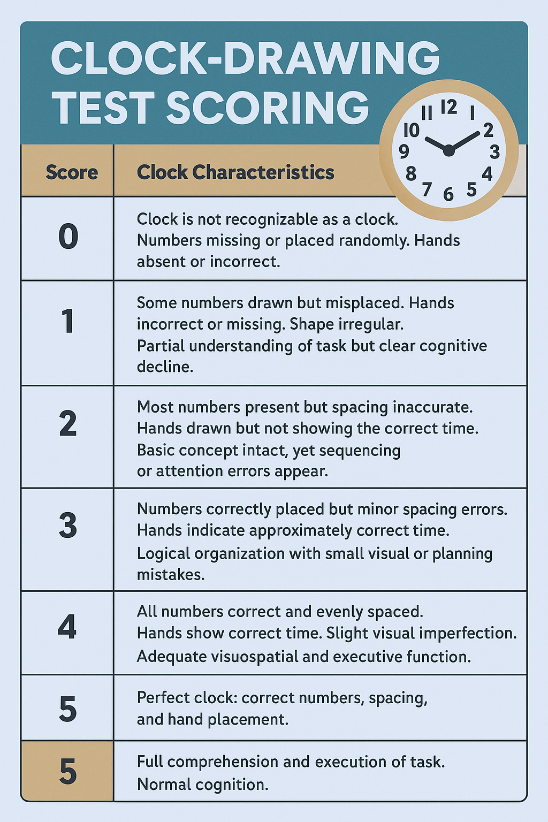
Notes:
he Clock Drawing Test (CDT) as a Reliable Screening Tool
The Clock Drawing Test (CDT) is a simple, fast, and reliable tool for detecting cognitive impairment. It evaluates visuospatial skills, executive functions, comprehension, and attention, domains that are often affected early in dementia and Alzheimer’s disease. Its practicality and cost-effectiveness make it ideal for both clinical and community settings.
Reliability and Replicability
The CDT demonstrates good test–retest reliability and high inter-rater reliability across several studies. For example, one normative study in Turkey reported test–retest reliability values of 0.81 (Manos–Wu method) and 0.72 (Shulman method), with inter-rater reliability reaching 0.98 (Manos–Wu). This consistency across scorers shows the test’s robustness (Turkish Journal of Neurology, 2018). A historical review found that the CDT has “solid psychometric properties, including test–retest and inter-rater reliability” (Aprahamian et al., 2018, Frontiers in Aging Neuroscience). However, more recent data indicate that reliability may be lower for very mild cognitive impairment in community-dwelling older adults (Salthouse et al., 2023).
In terms of replicability, although different scoring systems exist, results remain consistent when compared to standardized cognitive batteries such as the MMSE or CAMCOG (Cahn-Weiner et al., 2003).
Validity and Clinical Evidence
Numerous clinical studies confirm the CDT’s validity. In a large community-based sample of 13,557 individuals, sensitivity for detecting moderate-to-severe cognitive impairment was 77 % and specificity 87 % (Shulman, 2000, American Journal of Epidemiology). Meta-analyses report mean sensitivity and specificity values near 85 % (Sunderland et al., 1989, Psychiatric Times). In stroke survivors, the AUC for major neurocognitive disorder reached 0.73 (95 % CI 0.68–0.79), with 78 % sensitivity and 53 % specificity (BMC Neurology, 2023). These results confirm that the CDT is reliable for detecting moderate to severe impairment, though less sensitive for subtle or early deficits.
Why It Works
Drawing a clock requires integration of planning, memory, numerical understanding, and visuospatial organization—key cognitive processes often compromised in dementia. The CDT’s simplicity, minimal materials, and short administration time make it suitable for screening large populations efficiently (StrokEngine, 2022).
Limitations
Reduced sensitivity in mild cognitive impairment (American Journal of Epidemiology, 2000).
Variation in scoring methods affecting comparability (Aprahamian et al., 2018).
Influence of cultural and educational background (Ardila, 2022, Archives of Clinical Neuropsychology).
Conclusion
Overall, the CDT combines high reliability, good replicability, and strong clinical evidence supporting its use as a first-line screening tool. It effectively identifies moderate to severe cognitive impairment and is recommended as part of a comprehensive cognitive assessment battery.
References
Aprahamian, I., Martinelli, J. E., & Yassuda, M. S. (2018). Clock Drawing Test: A review of its psychometric properties. Frontiers in Aging Neuroscience, 10, 560.
Cahn-Weiner, D. A., et al. (2003). Clock drawing and the Mini-Mental State Examination as predictors of cognitive decline. Journal of the International Neuropsychological Society, 9(6), 930–935.
Salthouse, T. A., et al. (2023). Test-retest reliability of clock drawing in mild cognitive impairment. Journal of Geriatric Psychiatry and Neurology.
Shulman, K. I. (2000). Clock-drawing: Is it the ideal cognitive screening test? American Journal of Epidemiology, 160(8), 797–807.
Sunderland, T., et al. (1989). Clock Drawing in Alzheimer’s disease: A cross-cultural meta-analysis. Psychiatric Times, 6(4), 32–37.
BMC Neurology (2023). Diagnostic accuracy of the Clock Drawing Test for post-stroke cognitive impairment.
StrokEngine (2022). Clock Drawing Test (CDT) – Clinical Utility Overview.
Ardila, A. (2022). Influence of education and culture on clock drawing performance. Archives of Clinical Neuropsychology, 39(2), 175–185.

Slide 12
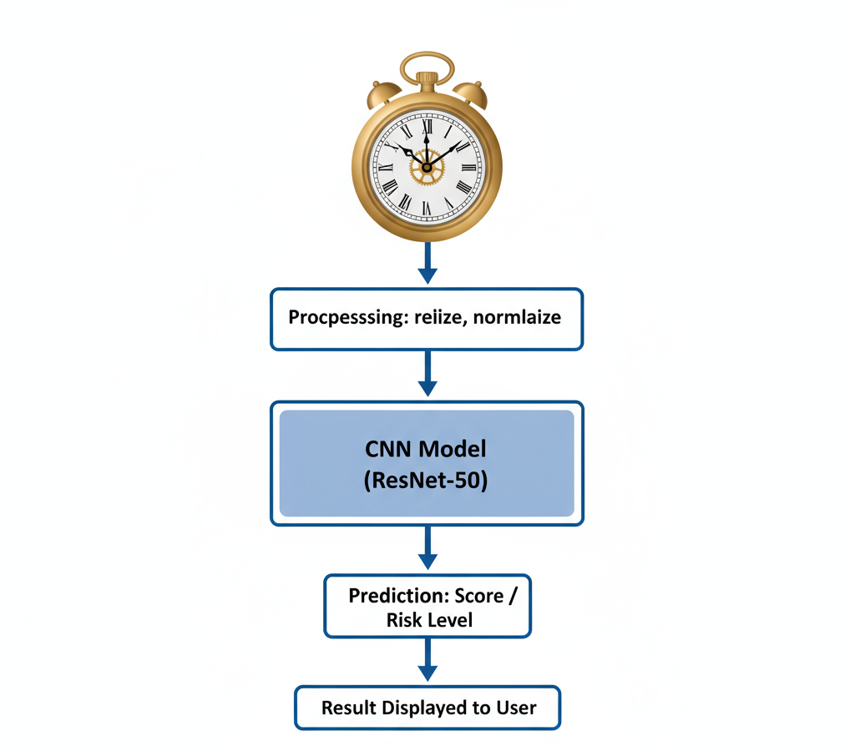
System Diagrama Pipeline

Slide 13
Success Metrics
Metric | Example | Target | Justification
Primary Metric | Model Accuracy | ≥ 90 % | Accuracy measures how well the CNN correctly classifies each clock drawing into the proper cognitive category (Normal, Mild, or Severe). A 90% target ensures the model performs at a clinically acceptable level, minimizing false negatives that could delay diagnosis.
Secondary Metric | Inference Time | < 1 second per image | In clinical or screening settings, decisions must be made quickly. Keeping inference time under 1 second allows real-time evaluation during consultations, enabling doctors to integrate the system seamlessly into their workflow without delays.
Additional Metric | Precision & Recall | ≥ 85 % each | Precision ensures the model’s positive predictions (e.g., “Impaired”) are correct, while recall measures how many actual impairments are detected. Balancing both prevents missing early-stage cases while avoiding over-diagnosis.
Robustness Metric | Performance under augmentation | Accuracy drop ≤ 5 % | This measures model stability when analyzing drawings with noise, lighting variations, or rotations. A small drop in accuracy indicates the model generalizes well across diverse input conditions, which is crucial for real-world applications.
Explainability Metric | Grad-CAM visualization clarity | Clinician agreement ≥ 80 % | Explainability tools like Grad-CAM highlight regions the CNN uses to make decisions. A high agreement rate among clinicians ensures the AI’s reasoning aligns with human clinical judgment, reinforcing trust and adoption.

Slide 14
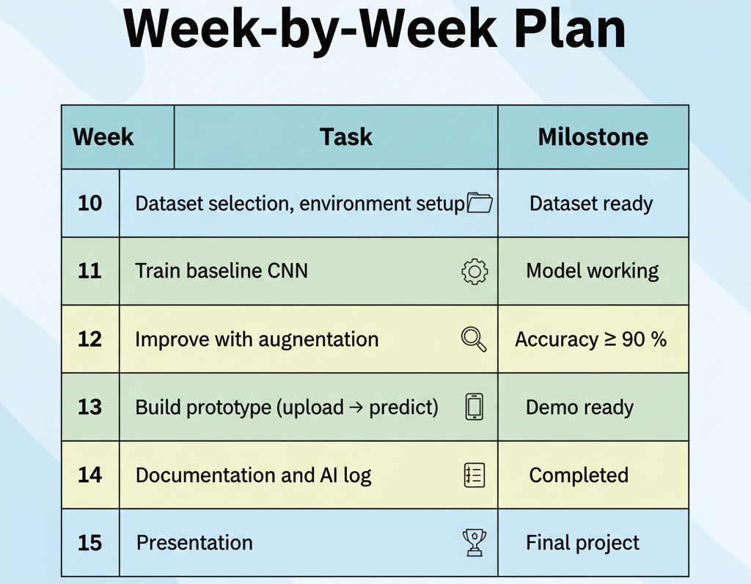

Slide 15
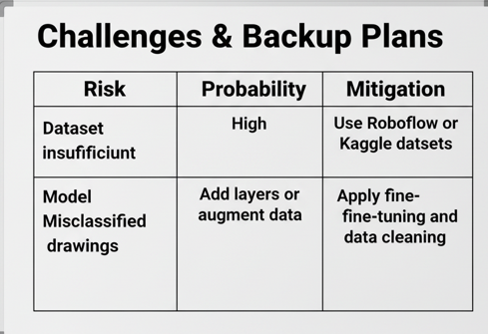

Slide 16
Resources Need
The images come from the NHATS, which stands for the National Health and Aging Trends Study. This is a large, federally funded longitudinal study conducted in the United States that focuses on the health, functioning, and well-being of older adults.
The NHATS dataset includes Clock Drawing Test (CDT) images collected from participants aged 65 and older, along with detailed clinical evaluations related to cognitive function. These drawings are part of standardized cognitive assessments used to study memory, attention, and executive functioning in aging populations.
In this project, the NHATS dataset provides both the hand-drawn clock images and their corresponding clinical scores, making it an ideal source for training a CNN model to predict levels of cognitive impairment automatically.

Slide 17
Thank you for your attention

